Slide 1


Algorithms on Graphs
Umang Bhaskar & Juhi Chaudhary
Day 2, session 2: TSP
STCS Vigyan Vidushi 2024

Slide 2
The Traveling Salesperson Problem
Given: $n$ points in $R^{2}$
point $a=\left(a_{x}, a_{y}\right),$distance $d\left(a,b\right)=\sqrt{{\left(a_{x}−b_{x}\right)}^{2}+{\left(a_{y}−b_{y}\right)}^{2}}$
e
b
a
c
f
d
g
h

Slide 3
The Traveling Salesperson Problem
Given: $n$ points in $R^{2}$
point $a=\left(a_{x}, a_{y}\right),$distance $d\left(a,b\right)=\sqrt{{\left(a_{x}−b_{x}\right)}^{2}+{\left(a_{y}−b_{y}\right)}^{2}}$
by triangle inequality, $d\left(a,b\right)≤d\left(a,c\right)+d\left(c,b\right)$
e
b
a
c
f
d
g
h

Slide 4
The Traveling Salesperson Problem
Given: $n$ points in $R^{2}$
point $a=\left(a_{x}, a_{y}\right),$distance $d\left(a,b\right)=\sqrt{{\left(a_{x}−b_{x}\right)}^{2}+{\left(a_{y}−b_{y}\right)}^{2}}$
by triangle inequality, $d\left(a,b\right)≤d\left(a,c\right)+d\left(c,b\right)$
e
b
a
c
(complete graph with edge lengths)
f
d
g
h

Slide 5
The Traveling Salesperson Problem
Given: $n$ points in $R^{2}$
point $a=\left(a_{x}, a_{y}\right),$distance $d\left(a,b\right)=\sqrt{{\left(a_{x}−b_{x}\right)}^{2}+{\left(a_{y}−b_{y}\right)}^{2}}$
TSP: find shortest possible cycle that visits all points.
e
b
a
c
(complete graph with edge lengths)
f
d
g
h

Slide 6
The Traveling Salesperson Problem
Given: $n$ points in $R^{2}$
point $a=\left(a_{x}, a_{y}\right),$distance $d\left(a,b\right)=\sqrt{{\left(a_{x}−b_{x}\right)}^{2}+{\left(a_{y}−b_{y}\right)}^{2}}$
TSP: find shortest possible cycle that visits all points.
e
b
a
c
(complete graph with edge lengths)
f
d
g
h

Slide 7
The Traveling Salesperson Problem
Given: $n$ points in $R^{2}$
point $a=\left(a_{x}, a_{y}\right),$distance $d\left(a,b\right)=\sqrt{{\left(a_{x}−b_{x}\right)}^{2}+{\left(a_{y}−b_{y}\right)}^{2}}$
TSP: find shortest possible cycle that visits all points.
Trivial algorithm:

Slide 8

The Traveling Salesperson Problem
Given: $n$ points in $R^{2}$
point $a=\left(a_{x}, a_{y}\right),$distance $d\left(a,b\right)=\sqrt{{\left(a_{x}−b_{x}\right)}^{2}+{\left(a_{y}−b_{y}\right)}^{2}}$
TSP: find shortest possible cycle that visits all points.
Trivial algorithm:
Each cycle corresponds to a permutation of the vertices
Try all $n!\sim 2^{n log n}$ permutations

Slide 9
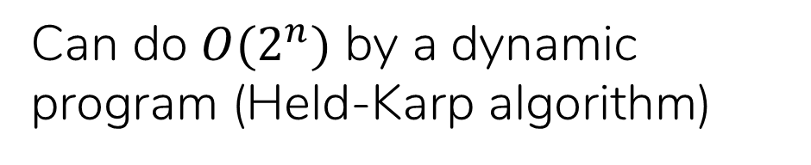
The Traveling Salesperson Problem
Given: $n$ points in $R^{2}$
point $a=\left(a_{x}, a_{y}\right),$distance $d\left(a,b\right)=\sqrt{{\left(a_{x}−b_{x}\right)}^{2}+{\left(a_{y}−b_{y}\right)}^{2}}$
TSP: find shortest possible cycle that visits all points.
Trivial algorithm:
Each cycle corresponds to a permutation of the vertices
Try all $n!\sim 2^{n log n}$ permutations
Better algorithms?
Can do $O(2^{n})$ by a dynamic program (Held-Karp algorithm)

Slide 10
The Traveling Salesperson Problem
Given: $n$ points in $R^{2}$
point $a=\left(a_{x}, a_{y}\right),$distance $d\left(a,b\right)=\sqrt{{\left(a_{x}−b_{x}\right)}^{2}+{\left(a_{y}−b_{y}\right)}^{2}}$
TSP: find shortest possible cycle that visits all points.
TSP is NP-hard
(what does this mean?)

Slide 11
The Traveling Salesperson Problem
Given: $n$ points in $R^{2}$
point $a=\left(a_{x}, a_{y}\right),$distance $d\left(a,b\right)=\sqrt{{\left(a_{x}−b_{x}\right)}^{2}+{\left(a_{y}−b_{y}\right)}^{2}}$
TSP: find shortest possible cycle that visits all points.
TSP is NP-hard
(what does this mean?)
There probably isn’t a polynomial-time algorithm for this problem.

Slide 12
The Traveling Salesperson Problem
Given: $n$ points in $R^{2}$
point $a=\left(a_{x}, a_{y}\right),$distance $d\left(a,b\right)=\sqrt{{\left(a_{x}−b_{x}\right)}^{2}+{\left(a_{y}−b_{y}\right)}^{2}}$
TSP: find shortest possible cycle that visits all points.
TSP is NP-hard
(what does this mean?)
There probably isn’t a polynomial-time algorithm for this problem.
Instead of an optimal solution, we look for a near-optimal solution.

Slide 13
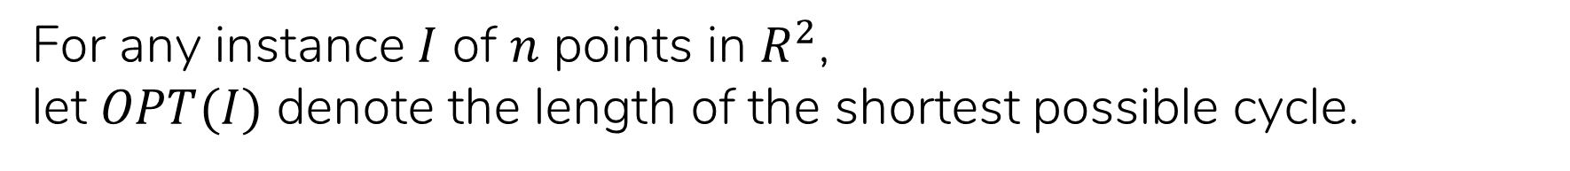
The Traveling Salesperson Problem
Given: $n$ points in $R^{2}$
point $a=\left(a_{x}, a_{y}\right),$distance $d\left(a,b\right)=\sqrt{{\left(a_{x}−b_{x}\right)}^{2}+{\left(a_{y}−b_{y}\right)}^{2}}$
TSP: find shortest possible cycle that visits all points.
For any instance $I$ of $n$ points in $R^{2}$,
let $OPT(I)$ denote the length of the shortest possible cycle.

Slide 14
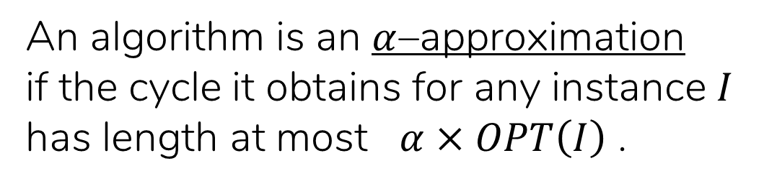
The Traveling Salesperson Problem
Given: $n$ points in $R^{2}$
point $a=\left(a_{x}, a_{y}\right),$distance $d\left(a,b\right)=\sqrt{{\left(a_{x}−b_{x}\right)}^{2}+{\left(a_{y}−b_{y}\right)}^{2}}$
TSP: find shortest possible cycle that visits all points.
For any instance $I$ of $n$ points in $R^{2}$,
let $OPT(I)$ denote the length of the shortest possible cycle.
Definition:
An algorithm is an $α$–approximation
if the cycle it obtains for any instance $I$
has length at most $α×OPT\left(I\right)$ .

Slide 15
The Traveling Salesperson Problem
Given: $n$ points in $R^{2}$
point $a=\left(a_{x}, a_{y}\right),$distance $d\left(a,b\right)=\sqrt{{\left(a_{x}−b_{x}\right)}^{2}+{\left(a_{y}−b_{y}\right)}^{2}}$
TSP: find shortest possible cycle that visits all points.
For any instance $I$ of $n$ points in $R^{2}$,
let $OPT(I)$ denote the length of the shortest possible cycle.
Definition:
An algorithm is an $α$–approximation
if the cycle it obtains for any instance $I$
has length at most $α×OPT\left(I\right)$ .
A 2-approximate algorithm gives a cycle of length at most $2×OPT\left(I\right).$

Slide 16
The Traveling Salesperson Problem
Given: $n$ points in $R^{2}$
point $a=\left(a_{x}, a_{y}\right),$distance $d\left(a,b\right)=\sqrt{{\left(a_{x}−b_{x}\right)}^{2}+{\left(a_{y}−b_{y}\right)}^{2}}$
TSP: find shortest possible cycle that visits all points.
For any instance $I$ of $n$ points in $R^{2}$,
let $OPT(I)$ denote the length of the shortest possible cycle.
Definition:
An algorithm is an $α$–approximation
if the cycle it obtains for any instance $I$
has length at most $α×OPT\left(I\right)$ .
We will give a 1.5-approximate algorithm for TSP.

Slide 17
The Traveling Salesperson Problem
find shortest possible cycle that visits all points.
Given: $n$ points in $R^{2}$
e
b
a
c
f
d
g
h

Slide 18
The Traveling Salesperson Problem
find shortest possible cycle that visits all points.
Given: $n$ points in $R^{2}$
graph
e
b
a
c
f
d
g
h

Slide 19
The Traveling Salesperson Problem
find shortest possible cycle that visits all points.
Given: $n$ points in $R^{2}$
graph
This is a minimum spanning tree!
e
b
a
c
f
d
g
h

Slide 20
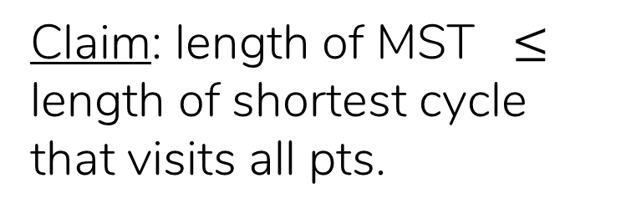
The Traveling Salesperson Problem
find shortest possible cycle that visits all points.
Given: $n$ points in $R^{2}$
graph
This is a minimum spanning tree!
Claim: length of MST $≤$ length of shortest cycle that visits all pts.
e
b
a
c
f
d
g
h

Slide 21
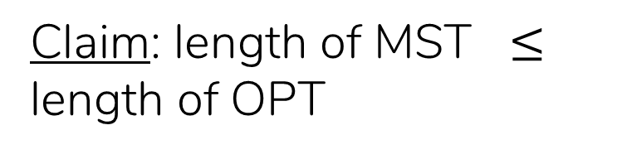
The Traveling Salesperson Problem
find shortest possible cycle that visits all points.
Given: $n$ points in $R^{2}$
graph
This is a minimum spanning tree!
Claim: length of MST $≤$ length of OPT
e
b
a
c
f
d
g
h

Slide 22
The Traveling Salesperson Problem
find shortest possible cycle that visits all points.
Given: $n$ points in $R^{2}$
graph
This is a minimum spanning tree!
Claim: length of MST $≤$ length of OPT
e
b
a
Sure, but we want a cycle...
c
f
d
g
h

Slide 23
The Traveling Salesperson Problem
find shortest possible cycle that visits all points.
Given: $n$ points in $R^{2}$
graph
This is a minimum spanning tree!
Claim: length of MST $≤$ length of OPT
e
b
a
Sure, but we want a cycle...
c
f
d
g
h

Slide 24
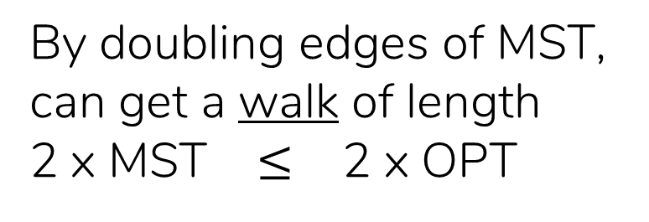
The Traveling Salesperson Problem
find shortest possible cycle that visits all points.
Given: $n$ points in $R^{2}$
graph
This is a minimum spanning tree!
Claim: length of MST $≤$ length of OPT
e
b
a
Sure, but we want a cycle...
c
f
By doubling edges of MST, can get a walk of length
2 x MST $≤$ 2 x OPT
d
g
h

Slide 25
The Traveling Salesperson Problem
find shortest possible cycle that visits all points.
Given: $n$ points in $R^{2}$
graph
This is a minimum spanning tree!
Claim: length of MST $≤$ length of OPT
e
b
a
Sure, but we want a cycle...
c
f
By doubling edges of MST, can get a walk of length
2 x MST $≤$ 2 x OPT
d
g
h
Can short-circuit walk to get a cycle of length $≤$ 2 x MST $≤$ 2 x OPT

Slide 26
The Traveling Salesperson Problem
find shortest possible cycle that visits all points.
Given: $n$ points in $R^{2}$
graph
This is a minimum spanning tree!
a – c – b – c – d – c – f – e – h – e – f – g – f – c – a
e
b
a
c
f
d
g
h
Can short-circuit walk to get a cycle of length $≤$ 2 x MST $≤$ 2 x OPT

Slide 27
The Traveling Salesperson Problem
find shortest possible cycle that visits all points.
Given: $n$ points in $R^{2}$
graph
This is a minimum spanning tree!
a – c – b – c – d – c – f – e – h – e – f – g – f – c – a
e
b
a
c
f
d
g
h
Can short-circuit walk to get a cycle of length $≤$ 2 x MST $≤$ 2 x OPT

Slide 28
The Traveling Salesperson Problem
find shortest possible cycle that visits all points.
Given: $n$ points in $R^{2}$
graph
This is a minimum spanning tree!
a – c – b – c – d – c – f – e – h – e – f – g – f – c – a
e
b
a
c
f
d
g
h
Can short-circuit walk to get a cycle of length $≤$ 2 x MST $≤$ 2 x OPT

Slide 29
The Traveling Salesperson Problem
find shortest possible cycle that visits all points.
Given: $n$ points in $R^{2}$
graph
This is a minimum spanning tree!
a – c – b – c – d – c – f – e – h – e – f – g – f – c – a
e
b
a
c
f
d
g
h
Can short-circuit walk to get a cycle of length $≤$ 2 x MST $≤$ 2 x OPT

Slide 30
The Traveling Salesperson Problem
find shortest possible cycle that visits all points.
Given: $n$ points in $R^{2}$
graph
This is a minimum spanning tree!
a – c – b – c – d – c – f – e – h – e – f – g – f – c – a
e
b
a
c
f
d
g
h
Can short-circuit walk to get a cycle of length $≤$ 2 x MST $≤$ 2 x OPT

Slide 31
The Traveling Salesperson Problem
find shortest possible cycle that visits all points.
Given: $n$ points in $R^{2}$
graph
This is a minimum spanning tree!
a – c – b – c – d – c – f – e – h – e – f – g – f – c – a
e
b
a
This gives us a 2-approximation algorithm for TSP.
c
f
d
g
h
Can short-circuit walk to get a cycle of length $≤$ 2 x MST $≤$ 2 x OPT

Slide 32
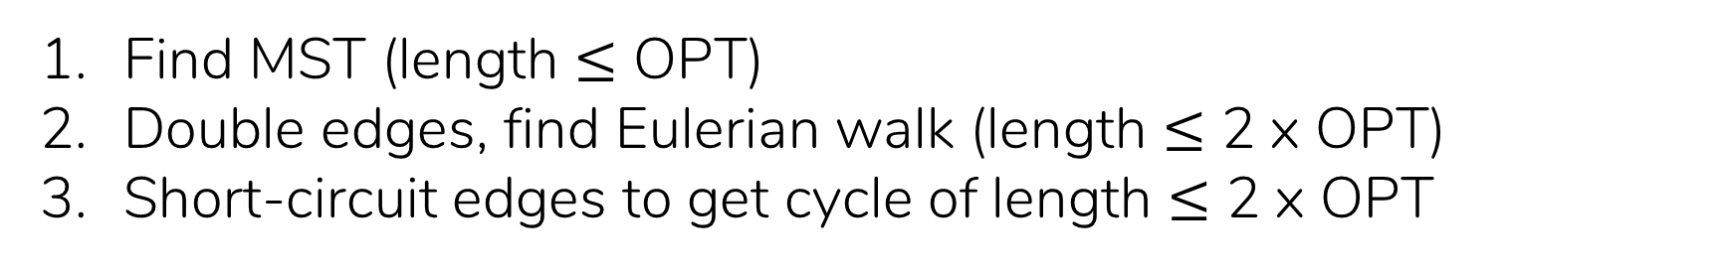
The Traveling Salesperson Problem
find shortest possible cycle that visits all points.
Given: $n$ points in $R^{2}$
A 2-approximation algorithm:
Find MST (length $≤$ OPT)
Double edges, find Eulerian walk (length $≤$ 2 x OPT)
Short-circuit edges to get cycle of length $≤$ 2 x OPT
(Remainder on board)

